Slide 1

Project 1 – Amplifier, EFM8 board, FSM, SPI EEPROM
University of British Columbia
Electrical and Computer Engineering
EECE281/EECE282
Dr. Jesús Calviño-Fraga P.Eng.
Department of Electrical and Computer Engineering, UBC
Office: KAIS 3024
E-mail: jesusc@ece.ubc.ca
Phone: (604)-827-5387
January 31, 2019

Slide 2
Objectives
Using an OpAmp to read the k-type thermocouple temperature.
Introduction to the EFM8 board.
Programming using Finite State Machines (FSMs) in assembly language.
Using SPI EEPROM for non-volatile variable storage and initialization.

Slide 3
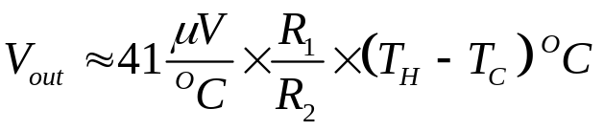
Amplifying the Thermocouple Voltage (with separated cold junction)
(+)Chromel
(-)Chromel
T_{H}
(-)Alumel
T_{C}
R₂
R₁
-
R₂
+
Difference Amplifier
R₁

Slide 4
Amplifying the Thermocouple Voltage
(+)Chromel
T_{H}
(-)Alumel
2Ω/m
T_{C}
R₂
R₁
-
R₂
+
Difference Amplifier
R₁

Slide 5
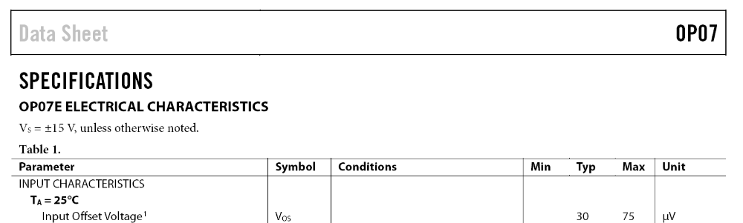
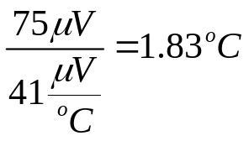
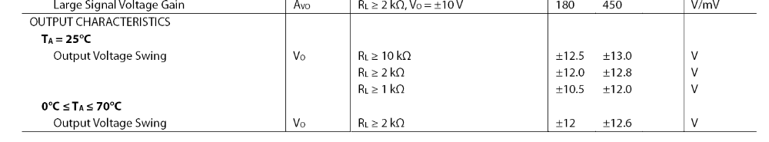
OP07 input offset voltage and output voltage swing

Slide 6
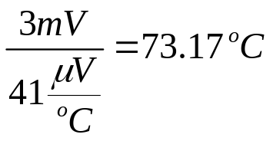
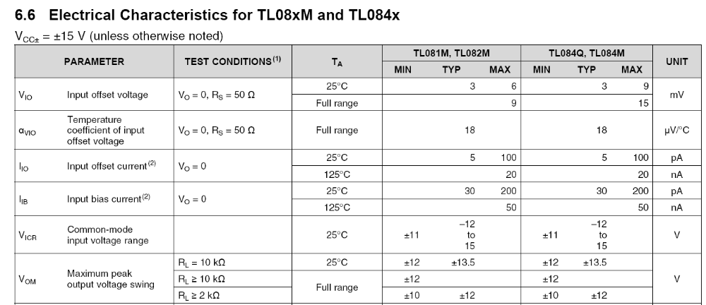
TL081 input offset voltage and output voltage swing

Slide 7
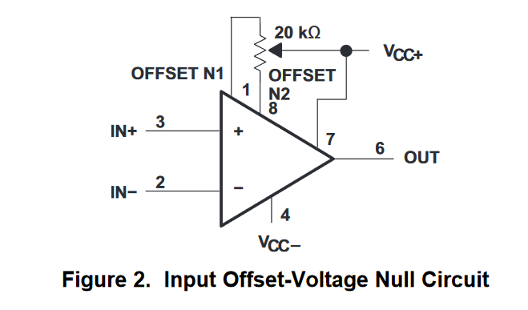
Offset Correction (only if needed!)
R₁
R₂
Adjust pot until ‘OUT’ is near zero mV.
R₂
R₁
Connect inputs of difference amplifier
Connect inputs of difference amplifier together and then to ground.

Slide 8
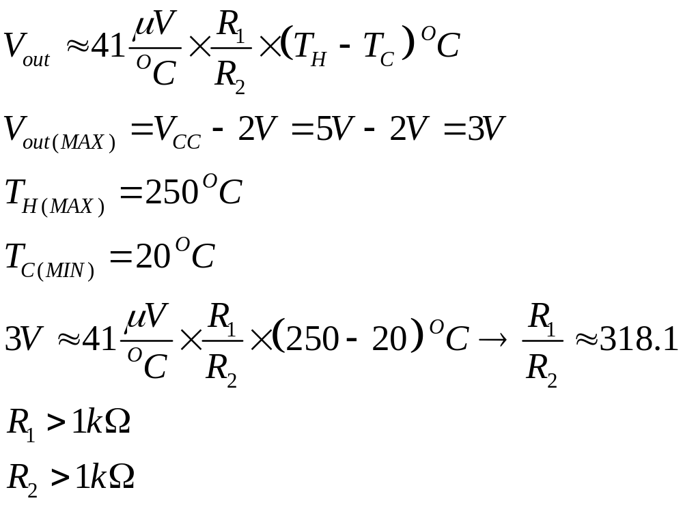
Selecting R1 and R2
A larger value of R₂ minimizes the error introduced by the thermocouple wire resistance (about 2Ω/m)

Slide 9
The EFM8 Board
Each student should have a EFM8 board for the second half of the course.
Each student should assemble (or try to) a EFM8 board. Stencil + Solder Paste + SMDs + TH + Testing.
The EFM8 board needs to be soldered in an reflow oven. You need a reflow oven controller! (If yours doesn’t work that well, I can let you use mine)

Slide 10
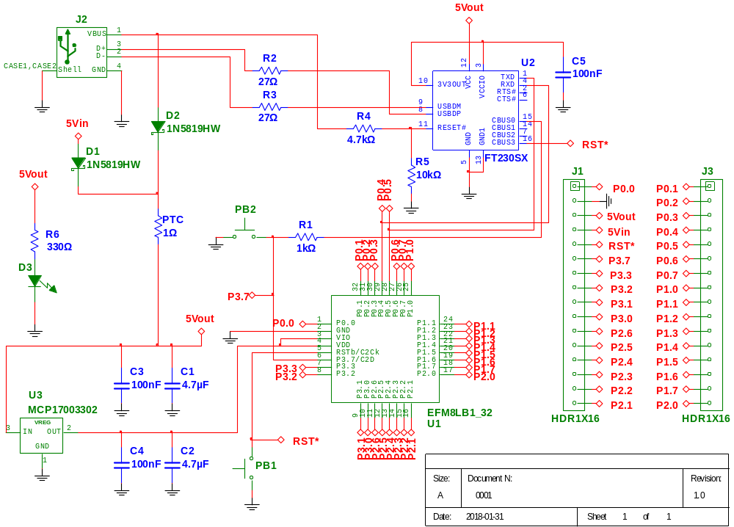
EFM8 circuit

Slide 11
EFM8 Bill of Materials (BOM)
Qty | Supplier's# | Reference | Man's # | Description
1 | 768-1135-1-ND | U2 | FT230XS-R | IC USB SERIAL BASIC UART 16SSOP
1 | MCP1700T3302ETTCT-ND | U3 | MCP1700T-3302E/TT | IC REG LDO 3.3V 0.25A SOT23-3
1 | 336-3736-ND | U1 | EFM8LB12F64E-B-QFP32 | IC MCU 8BIT 64KB FLASH 32QFP
2 | 450-1759-1-ND | PB1, PB2 | FSM4JSMATR | SWITCH TACTILE SPST-NO 0.05A 24V
2 | A26509-16-ND | J1, J3 | 4-103741-0-16 | CONN HEADR BRKWAY .100 16POS STR
1 | ED2983-ND | J2 | USB-B1HSB6 | CONN USB TYPE B R/A BLACK
2 | 1N5819HW-FDICT-ND | D1, D2 | 1N5819HW-7-F | DIODE SCHOTTKY 40V 1A SOD123
3 | 399-1170-1-ND | C3, C4, C5 | C0805C104K5RACTU | CAP CER 0.1UF 50V X7R 0805
2 | 311-22ARCT-ND | R2, R3 | RC0805JR-0722RL | RES SMD 22 OHM 5% 1/8W 0805
1 | 160-1179-1-ND | D3 | LTST-C170GKT | LED GREEN CLEAR 0805 SMD
1 | 311-330ARCT-ND | R6 | RC0805JR-07330RL | RES SMD 330 OHM 5% 1/8W 0805
1 | 311-1.0KARCT-ND | R1 | RC0805JR-071KL | RES SMD 1K OHM 5% 1/8W 0805
1 | 311-4.7KARCT-ND | R4 | RC0805JR-074K7L | RES SMD 4.7K OHM 5% 1/8W 0805
2 | 478-8125-1-ND | C1, C2 | F921A475MPA | CAP TANT 4.7UF 10V 20% 0805
1 | 507-1797-1-ND | PTC | 0ZCJ0020FF2E | PTC RESTTBLE 0.20A 30V CHIP 1206
1 | 311-10KARCT-ND | R5 | RC0805JR-0710KL | RES SMD 10K OHM 5% 1/8W 0805

Slide 12
Steps Assembling a PCB with SMDs.
Step 1: Apply solder paste to the PCB. You will use a Mylar stencil. (I personally believe this is the most critical step in the whole process!)
Step 2: Place the SMT components into the PCB.
Step 3: Reflow soldering. You will be using a toaster oven with a controller of your own design.
Step 4: Hand soldering of TH (thru hole) components.

Slide 13
Testing the EFM8 Board
Write a “blinky.asm” for the EFM8. Some things to take into account compared to the AT89LP51RC2:
  The default oscillator frequency is 6.000MHz. It can be configured for 12MHz, 24MHz, 48MHZ, and 72MHz… or many different values in between!
  The number cycles per instruction is different.
  The registers used to configure the ports are different. Check the datasheet!

Slide 14
blinky_EFM8.asm
$MODEFM8LB1
CSEG at 0H
ljmp main
Wait_half_second:
;For a 6MHz clock one machine cycle takes 1/6.0000MHz=166.666ns
mov R2, #25
L3: mov R1, #250
L2: mov R0, #120
L1: djnz R0, L1 ; 4 machine cycles-> 4*166.666ns*120=80us
djnz R1, L2 ; 80us*250=0.02s
djnz R2, L3 ; 0.02s*25=0.5s
ret
main:
; DISABLE WDT: provide Watchdog disable keys
mov WDTCN, #0xDE ; First key
mov WDTCN, #0xAD ; Second key
mov SP, #7FH
; Enable crossbar and weak pull-ups
mov XBR0, #0x00
mov XBR1, #0x00
mov XBR2, #0x40
mov P2MDOUT, #0x02 ; make LED pin (P2.1) output push-pull
M0: cpl P2.1 ; Led off/on
lcall Wait_half_second
sjmp M0
end

Slide 15
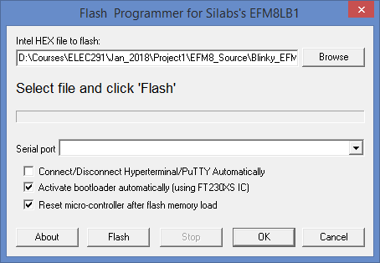
Flashing HEX file into EFM8 Board
In CrossIDE click fLash->Silabs EFM8LB1. Select the correct HEX file, make sure settings are like shown below, and then click ‘Flash’.

Slide 16
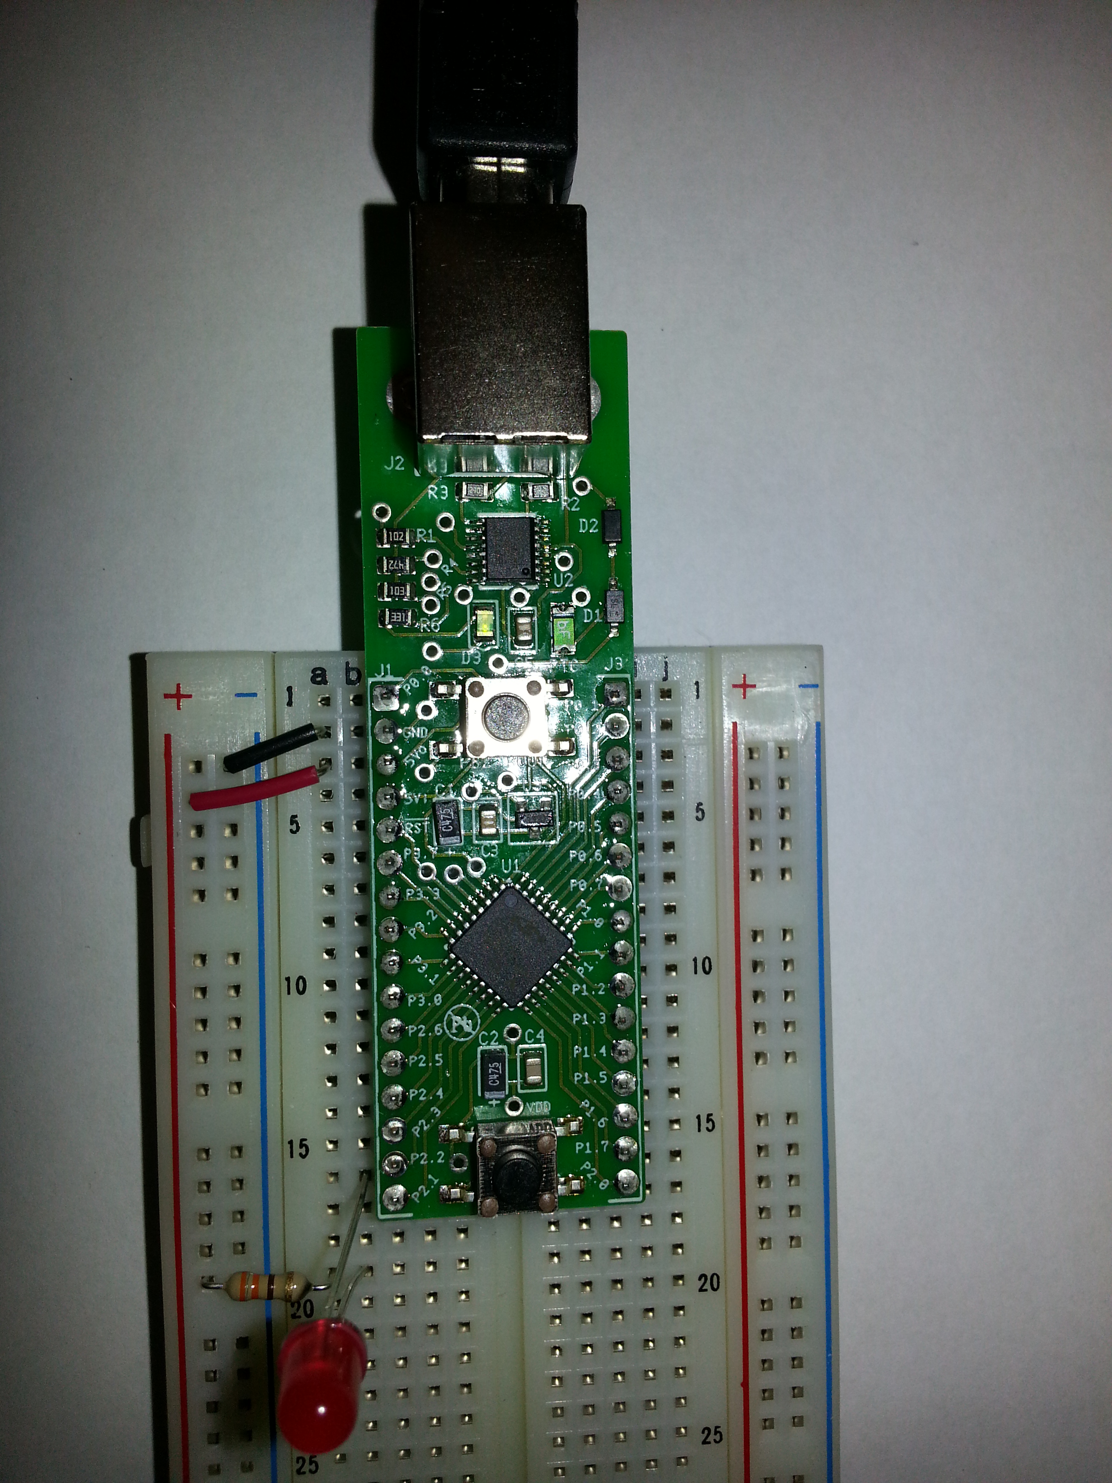
Testing the board with blinky_EFM8.asm in breadboard.

Slide 17
Finite State Machines in Assembly Language
A finite state machine (FSM) is a programming abstraction method that can be represented using a graph structure.
We can draw the states as circles and the transitions as arrows.
There is a finite number of states. The active state is called the current state.
FSMs are easily implemented in assembly language!
Many FMS can be run “concurrently”. (One after another really!)
FSM are in principle non-blocking.

Slide 18
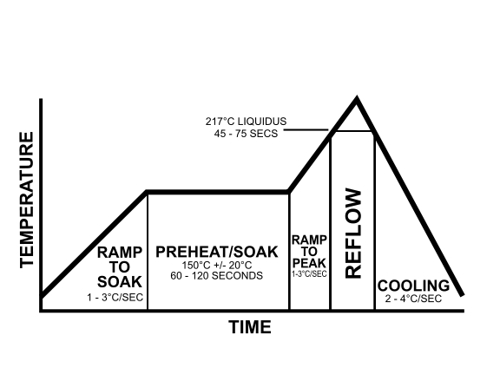
Reflow Profile States
http://en.wikipedia.org/wiki/Reflow_soldering
State 4
State 3
State 2
State 1
State 5
State 0

Slide 19
Reflow Profile FSM
Temp<=150ºC
Default state after reset
State 1
Temp>150ºC
Sec<=60s
Power=100%
Sec=0
Start=NO
Start=YES
State 2
Power=20%
State 0
Power=0%
Sec>60s
Temp<60ºC
Temp<=220ºC
Temp>=60ºC
Power=100%
Sec=0
State 3
State 5
Sec<=45s
Power=0%
Temp>220ºC
Sec>45s
State 4
Abort condition not shown!
Power=20%

Slide 20
In assembly (some states only!)
mov a, state
state0:
cjne a, #0, state1
mov pwm, #0
jb KEY.3, state0_done
jnb KEY.3, $ ; Wait for key release
mov state, #1
state0_done:
ljmp forever
state1:
cjne a, #1, state2
mov pwm, #100
mov sec, #0
mov a, #150
clr c
subb a, temp
jnc state1_done
mov state, #2
state1_done:
ljmp forever
state2:
cjne a, #2, state3
mov pwm, #20
mov a, #60
clr c
subb a, sec
jnc state2_done
mov state, #3
state2_done:
ljmp forever
    .
    .
    .
    .
    .
    .
    .

Slide 21
In assembly (some states only!) using variables…
mov a, state
state0:
cjne a, #0, state1
mov pwm, #0
jb KEY.3, state0_done
jnb KEY.3, $ ; Wait for key release
mov state, #1
state0_done:
ljmp forever
state1:
cjne a, #1, state2
mov pwm, #100
mov sec, #0
mov a, temp_soak
clr c
subb a, temp
jnc state1_done
mov state, #2
state1_done:
ljmp forever
state2:
cjne a, #2, state3
mov pwm, #20
mov a, time_soak
clr c
subb a, sec
jnc state2_done
mov state, #3
state2_done:
ljmp forever
    .
    .
    .
    .
    .
    .
    .
DSEG ; Before the state machine!
temp_soak: ds 1
Time_soak: ds 1
Temp_refl: ds 1
Time_refl: ds 1

Slide 22
About Variables
It is easy to work with binary (8-bit) variables. Use “inc”, “dec”, to increment/decrement and ‘subb’ to compare.
Small variables are easy to save and retrieve from non-volatile memory such as EEPROM.
If temperature measurements are too “noisy”, make several measurements and take the average!
To convert 8-bit binary variable to decimal use either HEX2BCD (in the math32 library) or this simple subroutine:

Slide 23
Binary to decimal conversion of 8-bit numbers in the 8051
; Eight bit number to display passed in ’a’.
PuTTy_Accumulator:
mov b, #100
div ab
orl a, #0x30 ; Convert hundreds to ASCII
lcall putchar ; Send
mov a, b ; Remainder is in register b
mov b, #10
div ab
orl a, #0x30 ; Convert tens to ASCII
lcall putchar ; Send
mov a, b
orl a, #0x30 ; Convert units to ASCII
lcall putchar ; Send
ret

Slide 24
DIV AB
DIV AB
Function: | Divide
Description: | DIV AB divides the unsigned eight-bit integer in the accumulator by the unsigned eight-bit integer in register B. The accumulator receives the integer part of the quotient; register B receives the integer remainder. The carry and OV flags will be cleared. Exception: If B had originally contained 00H, the values returned in the accumulator and B register will be undefined and the overflow flag will be set. The carry flag is cleared in any case.
Example: | The accumulator contains 251 (0FBH or 11111011B) and B contains 18 (12H or 00010010B). The instruction DIV AB will leave 13 in the accumulator (0DH or 00001101 B) and the value 17 (11H or 00010001B) in B, since 251 = (13x18) + 17. Carry and OV will both be cleared.
Operation: | DIV AB (A), (B) ¬ (A) / (B)
Encoding: | 1 | 0 | 0 | 0 | 0 | 1 | 0 | 0

Slide 25
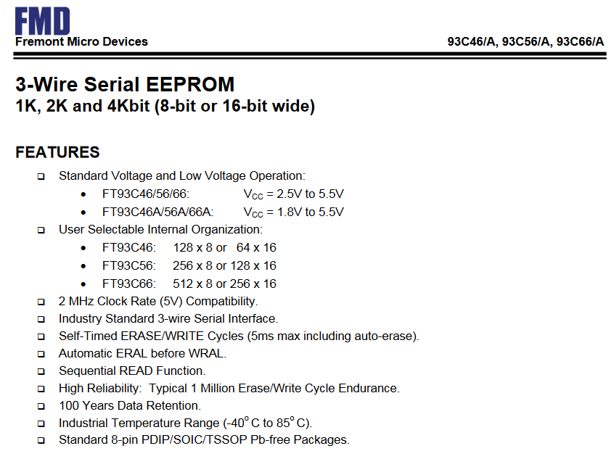
Non-Volatile Memory: 93C66

Slide 26
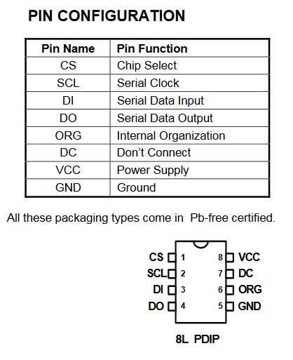
Non-Volatile Memory: 93C66

Slide 27
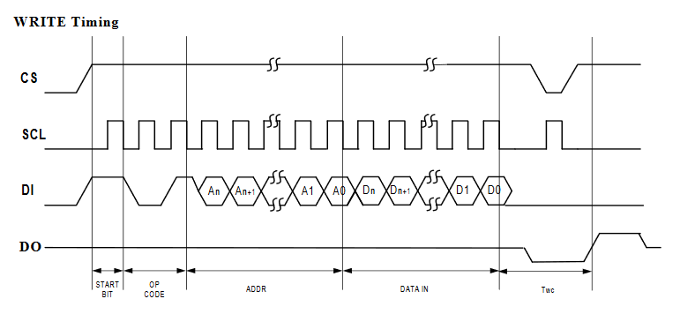
Non-Volatile Memory: 93C66
SPI!

Slide 28
Why non-volatile memory?
To save your reflow oven controller parameters so they are available automatically the next time you use it.
To store other useful information, such as the last reflow profile.

Slide 29
Connecting the 93C66 to 8051 processor
5V
P2.0
P2.1
P2.2
P2.3
(1)
(8)
CS VCC
DI DC
DO ORG
SCL GND
(3)
(7)
(4)
(6)
(2)
(5)
93C66

Slide 30
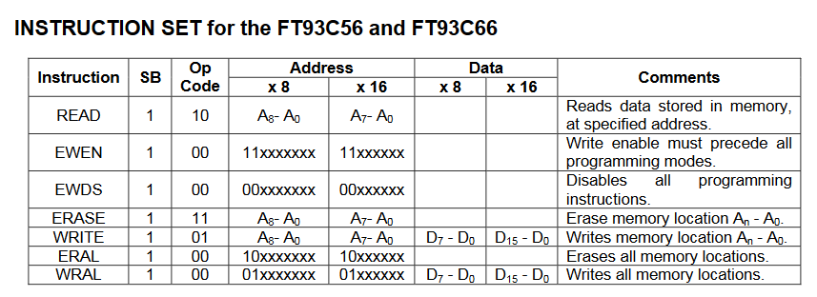
93C66 Instruction Set

Slide 31
93C66 Instruction Set (code)
; Address to read passed in dptr (dpl and dph)
; Value read, returned in accumulator
; READ: 110[A8] [A7 downto A0]
FT93C66_Read:
setb FT93C66_CE ; Activate the EEPROM.
lcall SmallDelay
mov a, #1100B
orl a, dph
mov R0, a ; Send start bit, op code, and MSB of address
lcall DO_SPI_G
mov R0, dpl ; Send LSB of address
lcall DO_SPI_G
mov R0, #11111111B ; Dummy value to receive data
lcall DO_SPI_G
mov a, R1
clr FT93C66_CE ; De-activate the EEPROM.
ret

Slide 32
93C66 Functions Provided
FT93C66_Write_Enable
FT93C66_Write_Disable
FT93C66_Read
FT93C66_Erase
FT93C66_Erase_All
FT93C66_Write
FT93C66_Write_All

Slide 33
93C66 Functions Example
lcall FT93C66_Write_Enable
mov dptr, #0x10 ; Random memory location to test
mov a, 0x55 ; Value to write at location
lcall FT93C66_Write
lcall FT93C66_Read
cjne a, #0x55, it_failed ; Read back and check
Example code in web page: EEPROM_test.asm

Slide 34
Example: Writing Project Data to EEPROM
Save_Configuration:
lcall FT93C66_Write_Enable
mov DPTR, #0
; Save variables
mov a, temp_soak
lcall FT93C66_Write
inc DPTR
mov a, time_soak
lcall FT93C66_Write
inc DPTR
mov a, temp_refl
lcall FT93C66_Write
inc DPTR
mov a, time_refl
lcall FT93C66_Write
inc DPTR
mov a, #0x55 ; First key value
lcall FT93C66_Write
inc DPTR
mov a, #0xAA ; Second key value
lcall FT93C66_Write
lcall FT93C66_Write_Disable
ret

Slide 35
Memory after writing 135, 45, 225, 35
Address | Data
0x000 | 0x87
0x001 | 0x2D
0x002 | 0xE1
0x003 | 0x23
0x004 | 0x55
0x005 | 0xAA
0x006 | ?
0x007 | ?
0x008 to 0x1FF | ?

Slide 36
Example: Read Project Data From EEPROM; check keys first!
Load_Configuration:
mov dptr, #0x0004 ;First key value location. Must be 0x55
lcall FT93C66_Read
cjne a, #0x55, Load_Defaults
inc dptr ; Second key value location. Must be 0xaa
lcall FT93C66_Read
cjne a, #0xaa, Load_Defaults

Slide 37
Example: Read From Flash; Load Saved Values
; Keys are good. Load saved values.
mov dptr, #0x0000
lcall FT93C66_Read
mov temp_soak, a
inc dptr
lcall FT93C66_Read
mov time_soak, a
inc dptr
lcall FT93C66_Read
mov temp_refl, a
inc dptr
lcall FT93C66_Read
mov time_refl, a
ret

Slide 38
Example: Read From Flash; Load Default Values
Load_Defaults: ; Load defaults if keys are incorrect
mov temp_soak, #150
mov time_soak, #45
mov temp_refl, #225
mov time_refl, #30
ret

